Slide 1

Hospital Management System
By: Ligia | Meenal | Rawaf

Slide 2
TOC
Introduction
Problem Description and Solution
Defining Entities and Attributes
Entity Relationship Diagram
Relational Database
Relational Design
Constraints
Validation Rules
Queries
Report

Slide 3

Introduction
River Edge Hospital located in New Jersey, Bergen county. They offer a comprehensive range of services to patients in a caring, culturally sensitive environment, accessing all of the specialties and resources. It’s the only care facility in the town of River Edge that has 300 staff members with over 100 patients are admitted and registered every day. As a small local hospital that has limited staff members and large incoming patients daily maintain their database system is mandatory.

Slide 4
Problem Description
Operating on the old paper system is not very efficient or reliable. Has a lot of setbacks and problems to medical staff & patients throughout the years.
Old sys is not a user-friendly or easy to use system. Records of inpatient and outpatient are not easily tracked and get overlapped.
1
3
2
The process of the old system is very time consuming that will not be helpful in an environment where time is extremely valuable.
4
Large number of patients, doctors & staff members make data processing more crucial to be organized in a system that will make it easy to access.

Slide 5
Project Objective & Solution
The main goal of automating hospital systems is to minimize the paperwork as minimum as possible.
Hospitals need a system that will enable their management to make effective and efficient decisions.
Help to easily track patients data, type of treatment they got. Also helps doctors to track their treated patients data.
Help in maintaining patient’s information, arranging doctors & nurses’ schedule, accessing patient’s records.
Also help patients to access their medical files, lab results and information about their case and diagnosis.
Notes:
Hospitals are key institutions they play a major role in a human’s life.
hospitals should be able to provide the best medical services and the best medical facility to their patients.
hospitals need a system that will enable their management to make effective and efficient decisions.
main goal is to minimize the paperwork as minimum as possible.
help in maintaining the patient’s information, arranging doctors & nurses’ schedule, accessing patient’s records to give the best diagnosis.
help patients to easily access their medical files, lab results and all the information that doctors provide about their case and diagnosis.

Slide 6
Defining Entities and Attributes
An Entity Relationship Model (ERM) is the result of systematic analysis to define and describe what is important to process in an area of business. However, it does not define the business processes; it only presents a business data schema in graphical form. Also, ERM defines a data or information structure implemented in a database, typically a relational database. Through graphic visualization, Entity Relationship diagram shows the various entities and relations between entities.

Slide 7
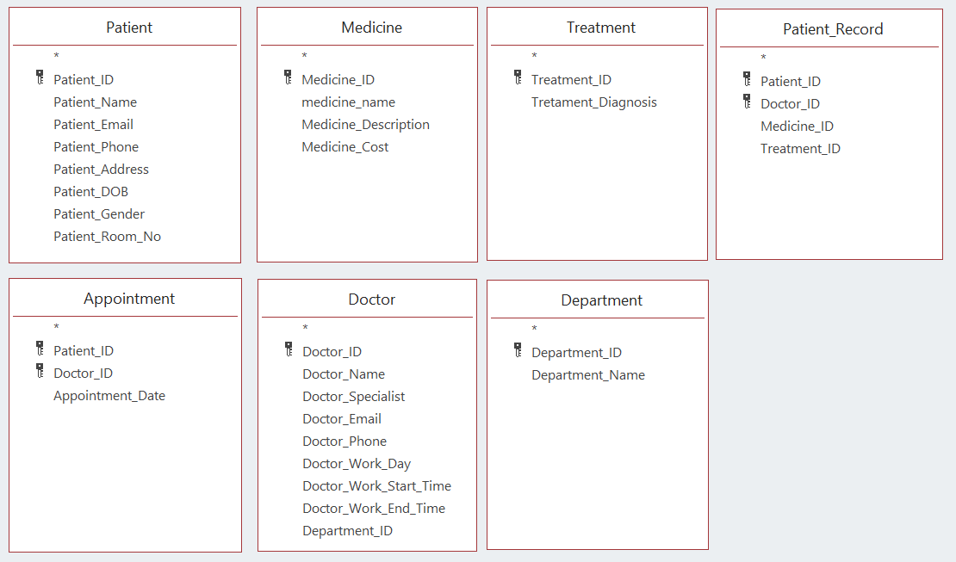
Classes and Attributes from Hospital Management System

Slide 8

One to One Relationship
1 : 1
A one-to-one relationship is a type of cardinality that refers to the relationship between two entities A and B in which one element of A may only be linked to one element of B, and vice versa. For instance, think of A as the set of all countries, and B as the set of all their capital city. Any country from A can and must have only one capital city from B, and vice versa.
In this database, no relationship is a one to one relationship.

Slide 9

One to Many Relationships
1 : N
A one-to-many relationship is a type of cardinality that refers to the relationship between two entities A and B in which an element of A may be linked to many elements of B, but a member of B is linked to only one element of A. For instance, think of A as mother, and B as kids. A mother can have many kids, but a kid can only have one mother.
PATIENT 1 : N APPOINTMENT
DOCTOR 1 : N APPOINTMENT
DEPARTMENT 1 : N DOCTOR
PATIENT 1 : N PATIENT_RECORD
MEDICINE 1 : N PATIENT_RECORD
TREATMENT 1 : N PATIENT_RECORD
DOCTOR 1 : N PATIENT_RECORD

Slide 10

Many to Many Relationships
N : M
A many-to-many relationships is a type of cardinality that refers to the relationship between two entities A and B in which A may contain a parent instance for which there are many children in B and vice versa. For example, think of A as Classes, and B as Students. A Class can have several Students, and a Student can be registered in several Classes.
Due to the fact that many medicines can be prescribed to many treatments, it was introduced the additional entity MEDICINE_TREATMENT. The same occurs with PATIENT_TREATMENT.
PATIENT N : M TREATMENT
MEDICINE N : M TREATMENT
DOCTOR N : M TREATMENT
PATIENT 1 : N PATIENT_RECORD
MEDICINE 1 : N PATIENT_RECORD
TREATMENT 1 : N PATIENT_RECORD
DOCTOR 1 : N PATIENT_RECORD

Slide 11
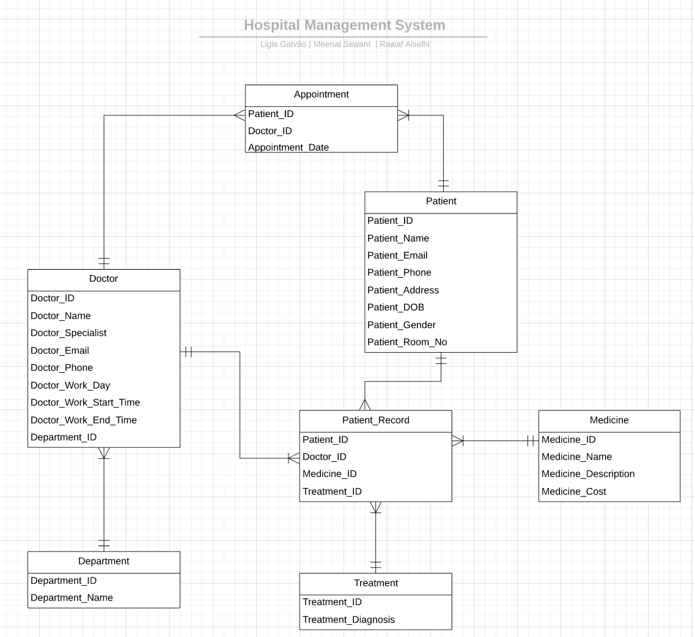
Entity Relationship Model Diagram

Slide 12

Relational Model
The Relational database represents the relation between tables. Primary key uniquely identifies the records the row of that table. Foreign key of one table is a primary of another table. Referential integrity constraints is based on the concept of Foreign Keys. Referential integrity constraint ensures that the values of one column in a table are valid based on values in another table. However, that key element in child table (FK) must exist in the parent table(PK). The advantage of the relational model are insert, select, modify and delete these operations can be performed in Relational Model and it minimizes the data redundancy issues.

Slide 13
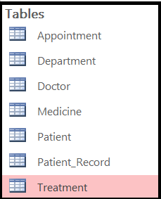
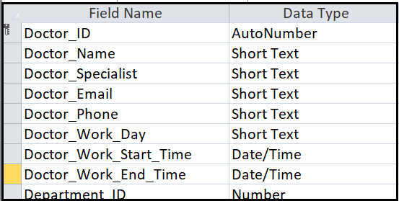
Tables and data types

Slide 14
Relational Design
Patient(Patient_ID(PK), Patient_Name, Patient_Email, Patient_Phone,Patient_Address, Patient_DOB, Patient_Gender, Patient_Room_No)
Appointment(Patient_ID(PK, FK),Doctor_ID(PK, FK), Appointment_Date)
Doctor(Doctor_ID(PK), Doctor_Name, Doctor_Specialist, Doctor_Email, Doctor_Phone, Doctor_Work_Day, Doctor_Work_Start_Time, Doctor_Work_End_Time, Department_ID(FK))
Department(Department_ID(PK), Department_Name)
Treatment(Treatment_ID(PK), Treatment_Diagnosis)
Medicine(Medicine_ID(PK), Medicine_Name, Medicine_Description, Medicine_Cost)
Patient_Record(Patient_ID(PK, FK), Doctor_ID(PK, FK), Medicine_ID(FK), Treatment_ID(FK)

Slide 15
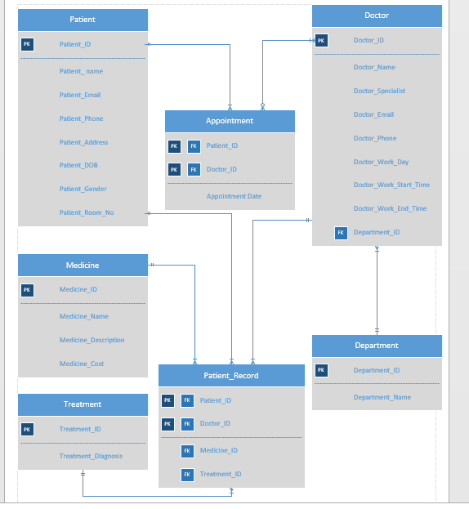
Logical design

Slide 16

Constraints
For all the above relationships, We have enforced Referential Integrity to avoid the loss or inadvertent updating of data in the tables. Primary key in the table which are referenced in other tables as foreign keys have this integrity enforced. Also, we have applied Cascade Update, Cascade Delete so that whenever we update/delete the data in the parent table, the respective foreign key in the referenced table would get updated.

Slide 17
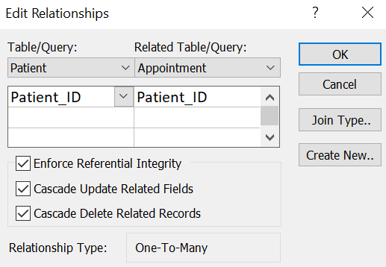
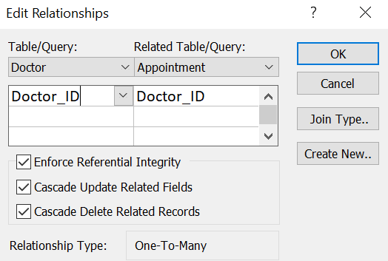
Constraints

Slide 18
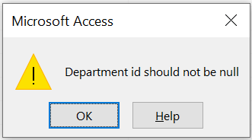
Validation Rules
We have also added validation rule ‘Is not NULL’ for several fields in our tables where we wanted to enforce no null values for the field. Example: Department_ID in the Doctor table
.

Slide 19
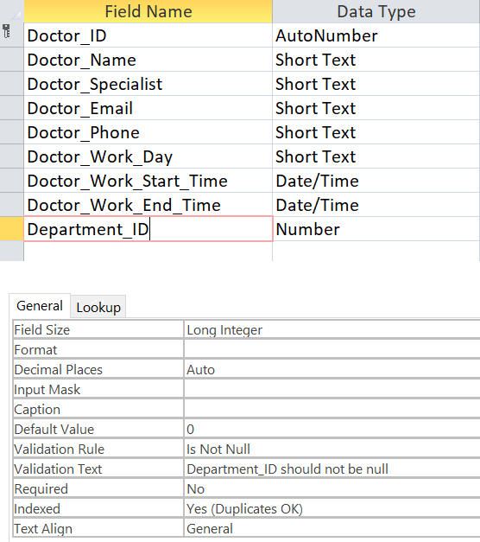
Validation Rule: Is Not Null

Slide 20
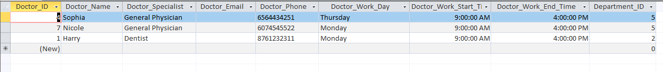
Queries
SQL:
Number of doctors who their specialist is either “ General Physician” or “Dentist”:
1
SELECT *
FROM DOCTOR
WHERE Doctor_SPECIALIST IN( 'General Physician','Dentist');
Result:

Slide 21
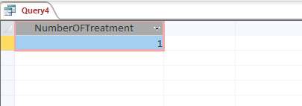
Queries
SQL:
Number of patients who got a root canal treatment:
2
SELECT COUNT(patient_ID) AS NumberOFTreatment
FROM Patient_Treatment
WHERE Treatment_ID = 1;
Result:

Slide 22
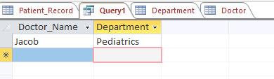
Queries
SQL:
Find all Doctors who in the Pediatric department:
3
SELECT Doctor.Doctor_Name, Department.Department_name
FROM Doctor INNER JOIN Department ON Doctor.Department_ID = Department.Department_ID
WHERE Department.Department_Name = "Pediatrics";
Result:

Slide 23
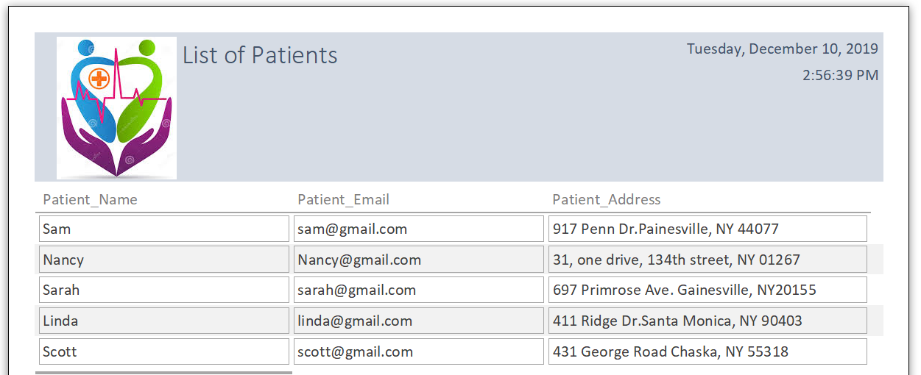
Example Report

Slide 24
Thank You

